Slide 1
HUMANOID ROBOT AL SAIAARI MOHAMMED NASSER 1734429

Slide 2
Table of contents
01
02
03
04
History
Application
Components & Design
Navigation System

Slide 3
Introduction
A humanoid robot is an impressive technological creation designed to closely emulate the physical characteristics and capabilities of humans. These remarkable machines possess a humanoid form, encompassing a head, torso, limbs, and even facial features, allowing them to closely resemble the human appearance. The intricate engineering and design behind humanoid robots aim to enable them to perform tasks and functions that are typically associated with humans.
The development of humanoid robots stems from the desire to create intelligent machines capable of seamlessly interacting with humans in various social, professional, and domestic settings. By emulating human-like movements, gestures, and locomotion, these robots aspire to bridge the gap between human and machine, facilitating more intuitive and natural communication between humans and robots
humanoid robots represent a remarkable fusion of robotics, artificial intelligence, and human-like design, aiming to create machines capable of engaging with humans in a more intuitive and meaningful way. As the field of robotics continues to evolve, the potential of humanoid robots to revolutionize industries and redefine our relationship with technology is a captivating prospect.

Slide 4
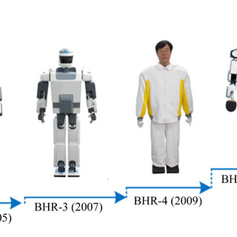
01
History

Slide 5
1- Historical Roots of Humanoid Robots:
2- Early Innovations:
In the 20th century, numerous inventors and engineers made significant contributions to the field of humanoid robotics. One notable example is Nikola Tesla, who developed the "Televox" robot in 1898. This groundbreaking creation could respond to voice commands and perform basic tasks. Another milestone came in the 1920s with Karel Čapek's play "R.U.R. (Rossum's Universal Robots)," introducing the term "robot" and portraying humanoid robots called "Robots."
The concept of humanoid automatons can be traced back to ancient civilizations. References to mechanical slaves crafted by Hephaestus, the Greek god of workmanship, can be found in Greek mythology. Similarly, ancient hinnies, Indian, and Egyptian societies have fables and traditions describing humanoid-like robots.

Slide 6
3- WABOT-1 and Early Breakthroughs:
4- ASIMO and Advancements in Humanoid Robotics:
In the 20th century, numerous inventors and engineers made significant contributions to the field of humanoid robotics. One notable example is Nikola Tesla, who developed the "Televox" robot in 1898. This groundbreaking creation could respond to voice commands and perform basic tasks. Another milestone came in the 1920s with Karel Čapek's play "R.U.R. (Rossum's Universal Robots)," introducing the term "robot" and portraying humanoid robots called "Robots."
In 1973, Waseda University in Japan unveiled WABOT-1, often regarded as the world's first full-scale humanoid robot. Standing at 1.85 meters tall and featuring 50 degrees of freedom, WABOT-1 could walk, manipulate objects, and communicate through a voice synthesizer. This achievement marked a significant milestone in humanoid robot development.

Slide 7
5- Boston Dynamics and Dynamic Humanoid Robots:
6- Sophia and Social Humanoid Robots:
Founded in 1992, Boston Dynamics has made remarkable strides in humanoid and bipedal robotics. Their creations, including Atlas and Spot, demonstrate exceptional mobility, agility, and dynamic balance. These robots have showcased the ability to navigate uneven terrain, open doors, and manipulate objects. Boston Dynamics' advancements have pushed the boundaries of what humanoid robots can achieve.
Developed by Hanson Robotics, Sophia garnered significant attention for its remarkably human-like appearance and expressions. Although primarily a social robot, Sophia has made strides in facial recognition, natural language processing, and speech synthesis. It serves as a prominent example of the intersection between humanoid robotics and artificial intelligence.

Slide 8
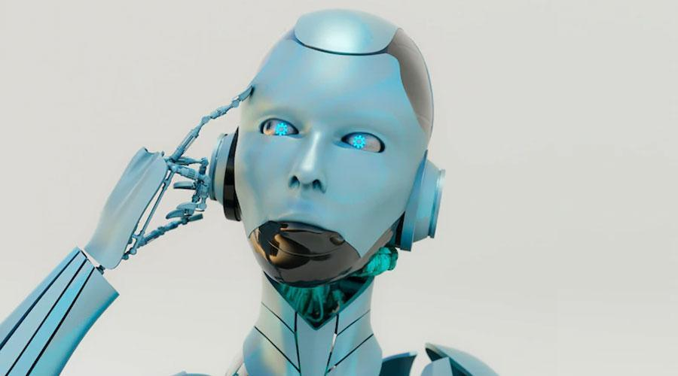
02
Application

Slide 9
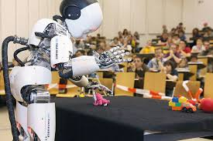
Applications of Humanoid Robots: 1- Assistance and Caregiving 2- Healthcare 3- Education and Research 4- Entertainment and Hospitality 5- Industrial Automation 6- Search and Rescue Operations 7- Social Interaction and Companionship 8- Space Exploration

Slide 10
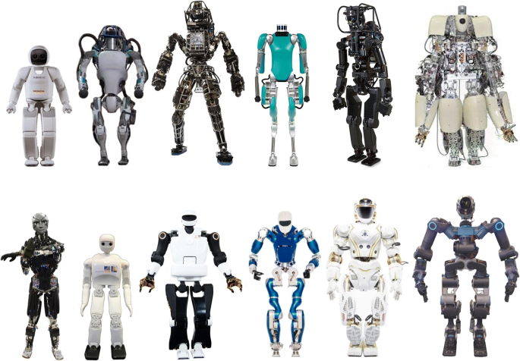
03
Components & Design

Slide 11
Main Components
Data Transmission
Propulsion System
Data Collection
Navigation & Control System
Frame & Desgin
Power Managment

Slide 12
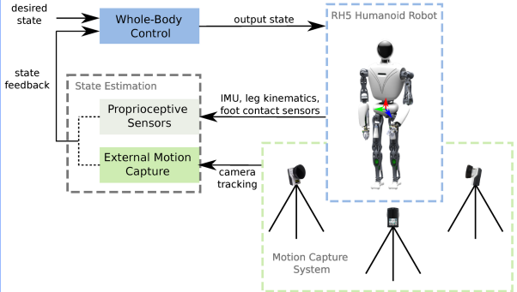
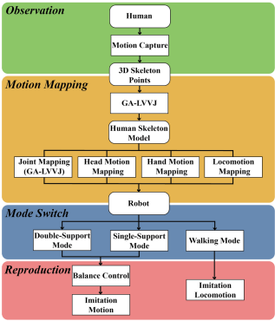

Slide 13
Frame & Design
1- Structural Frame: provides support and stability to the overall robot’s body
2- Joints & Actuators: To achieve a range of movements and postures similar to Humans
3- Sensory Integration: Cameras, depth sensors, touch sensors, force sensors, accelerometers, and gyroscopes
4- Anthropopathism: Considering andromorphic proportions and ergonomics in their design.
The frame and hull are designed to resemble human body segments, with considerations for limb length, joint placement, and range of motion

Slide 14
Navigation & Control System
1- Sensors: Offer information about the robot's location, orientation, distance to an item, and detection of obstacles.
2- Perception & Mapping: building a map of the surroundings, identifying items, and estimating their locations and distances using SLAM.
3- Path Planning: Algorithms for path planning take into account obstacles, the robot's physical capabilities, and any constraints or goals set forth by the task at hand.
4- Localization: involves comparing sensor data to the map, figuring out the robot's pose (position and orientation), and then comparing it to the map.

Slide 15
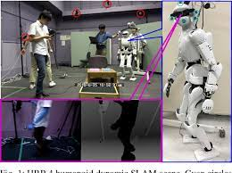
Data Collection
Sensor:
Cameras
IMUs
LiDAR
Ultrasonics sensor
Force/Torque sensor
Actuators:
Electric Motors
Hydraulic Actuators
Pneumatic Actuators
Series Elastic Actuators (SEA)
Grippers/End Effectors

Slide 16
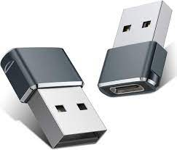
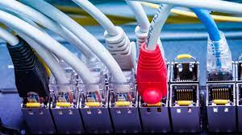
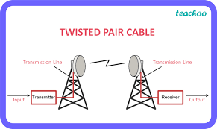

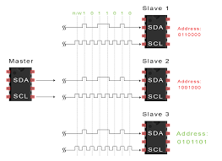
Data Transmissionb
USB
WIFI
Ethernet
I2C
Radio

Slide 17
Propulsion System
Electrical Motors
For rotational motion and actuation, enabling it to walk, grasp objects, and other tasks.
Hydraulic Systems:
For difficult tasks such as heavy lifting
Pneumatic Systems
For rapid and responsive actuation
Hybrid
For variable and adaptable movement,
Elastic Actuators
Include elastic components in the motor and the joint to provide compliant, force-controlled movement.
Legged & Wheeled
For effective mobility on flat terrain and allow the robot to traverse different terrains and avoid impediments

Slide 18
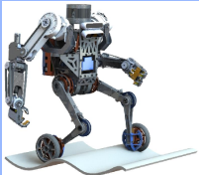
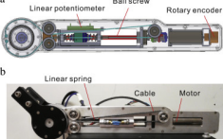
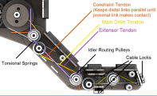
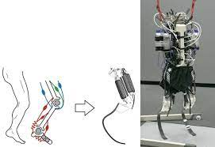
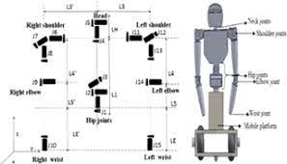
Propulsion System

Slide 19
Power Management
Battery Power Management:
Regulated battery charging and draining ensures peak performance.
Power Saving Techniques:
Utilize sleep or idle modes for subsystems that are not actively performing tasks
3. Power Distribution & Regulation: PDUs deliver power from the primary source to the humanoid robot's different subsystems and parts.
Energy Harvesting:
Providing a renewable and continuous power source
Charging and Docking Stations
Equip robots with an easy and automatic approach to recharge their batteries while they are not working on jobs

Slide 20
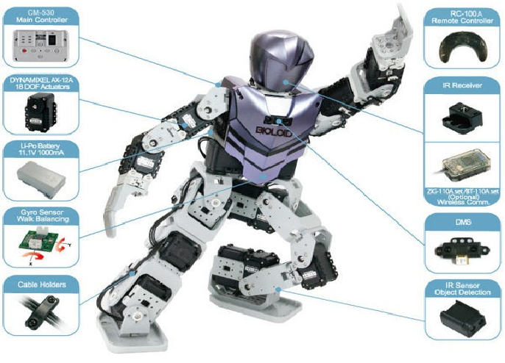

Slide 21
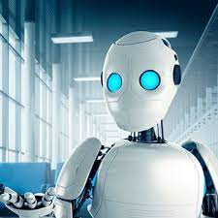
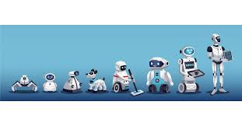
Thank You Q n A?

